Slide 1
Analysis of the Effect of Industry on Scaled Stock Returns
Name:
Student Number:

Slide 2
Research Requirements
Description:
The various independent variables are dividends, on scaled stock returns. Mr. John Hughes wants to understand the impact of these variables.
Objectives:
Using a linear regression model, analyze the effect of dividends on scaled stock.
Notes:
Elaborate the importance of the research in market behaviour and investment strategies perspective.

Slide 3
Basic Statistics
Mean the average scaled stock returns in the dataset.
From SD, it is visible that high variability in stock returns.
Minimum is the lowest scaled stock return.
Maximum is some stocks with extremely high returns.
Mean | SD | Minimum | Maximum
194.00 | 135.00 | 30.40 | 985.00

Slide 4
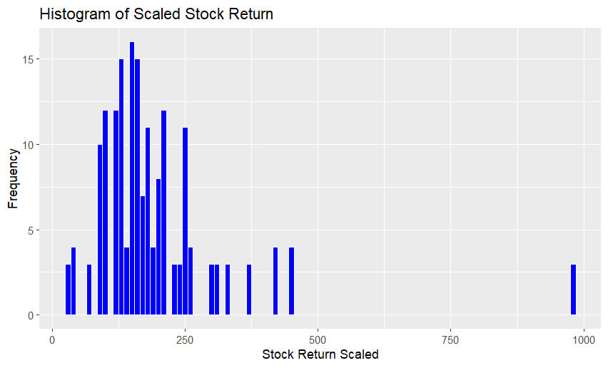
Histogram of Scaled Stock Return

Slide 5
Histogram of Scaled Stock Return
Distribution Shape: Right-skewed
Frequency of Returns: Highest in the range of 100 to 250
Presence of Outliers: Observations above 500
Bins and Spread: Detailed view with bin width of 10
Overall Range: From 30.40 to 985.00

Slide 6
T-test Results
Hypothesis Testing:
Null Hypothesis (H0): Mean of stock_return_scaled = 300
i.e. μ = 300
Alternative Hypothesis (H1): Mean of stock_return_scaled ≠ 300
i.e. μ ≠ 300

Slide 7
T-test Results
Values:
T-statistic | Degrees of Freedom | P-value | Sample Mean | 95% Confidence Interval for the Mean
10.511 | 179 | <2.2e−16 | 194.173 | [174.3052,214.0408]

Slide 8
Explanation of Results
T-Statistic: It shows that the sample mean is lower than the hypothesized mean of 300.
P-Value: From P-value, strong evidence against null hypothesis can be observed.
Confidence Interval: The value 300 is not included. So, in conclusion it can be said that the true mean is significantly different from 300.
In conclusion, reject the null hypothesis H0. The mean of stock_return_scaled is significantly different from 300.

Slide 9
Simple Linear Regression (Dividend)
Simple Linear Regression Model:
stock_return_scaled = 196.903 − 5.118 * dividend
Intercept | Slope
196.903 | -5.118

Slide 10
Interpretation and Evaluation
Intercept (196.903): When dividend = 0, this is the expected value of stock_return_scaled.
Slope (-5.118): For each one-unit increase in the dividend, this is the expected decrease in stock_return_scaled.
R-squared Value: Dividend can explain only about 0.036% of the variability in stock_return_scaled.
Adjusted R-squared: From here it can be said that, the model is worse if only mean of the dependent variable is used alone.
F-statistic and p-value: It shows that there is no statistically significant relationship between dividend and stock_return_scaled.
In conclusion it can be said that, dividends do not have a statistically significant impact on stock returns in this dataset.

Slide 11
Multiple Linear Regression
Multiple Linear Regression Model:
stock_return_scaled = 12.63174 + 0.12446 * return +
156.93738 * market_overviewneutral + 105.98573 *
market_overviewpositive - 21.58592 * dividend + 4.33123 *
earnings_ranking - 69.37919 * debt_to_equity - 0.16433 *
marketcap

Slide 12
Summary of Results
Intercept (12.63174): This is the expected value when all independent variables are zero.
Coefficients: Model Fit:
Return: Marginally significant relationship.
Market Overview Neutral: Significant positive impact.
Market Overview Positive: Significant positive impact.
Dividend: Negative relationship,
not statistically significant.
Earnings Ranking: Slight positive relationship,
not statistically significant.
Debt to Equity: Significant negative impact.
Market Capitalization: Highly significant negative impact.
In conclusion, stock_return_scaled is impacted by several variables, which are particularly market overview variables, debt to equity ratio, and market capitalization.
Multiple R-squared | Adjusted R-squared | F-statistic | Residuals
0.647 | 0.6326 | 45.03 with a p-value < 2.2e-16 | from -157.07 to 480.30

Slide 13
Overall Findings
Market Overview as a Key Driver: Scaled stock returns is significantly influenced by market sentiment.
Debt to Equity Ratio: Higher levels of debt relative to equity lead to diminished returns.
Market Capitalization's Detrimental Effect: Lower scaled stock returns are experienced by larger firms.
Limited Impact of Dividends and Earnings Ranking: Statistically significant effects are not exhibited by dividends and earnings ranking.

Slide 14
Implications and Future Research
Implications for Investors:
Focus on Market Sentiment:
Evaluate Financial Strength:
Consider Smaller Firms
Future Research Suggestions:
Broader Variables
Longitudinal Studies
Sector-Specific Analysis
The study uncovers essential drivers impacting stock returns, empowering investors to fine-tune their strategies and make informed decisions in dynamic market environments.

